Slide 1
Supply chain optimization using predictive analytics to reduce costs
By
Satya Veni Chelluboina

Slide 2
introduction
Supply chain optimization is the process of streamlining the flow of goods and services from suppliers to customers, with the goal of reducing costs and improving efficiency. It involves various aspects such as inventory management, transportation, production, and logistics.
In recent years, predictive analytics has emerged as a powerful tool in supply chain optimization. Predictive analytics involves the use of data, statistical algorithms, and machine learning techniques to identify patterns and predict future outcomes. By leveraging predictive analytics, companies can gain insights into consumer demand, optimize inventory levels, improve production planning, and optimize logistics operations.
In today's highly competitive market, supply chain optimization has become a critical area for businesses seeking to remain profitable and competitive. Predictive analytics can help companies achieve these objectives by reducing costs, improving efficiency, and enhancing customer satisfaction. In this presentation, we will explore how predictive analytics can be used to optimize supply chain operations and reduce costs while improving efficiency.

Slide 3
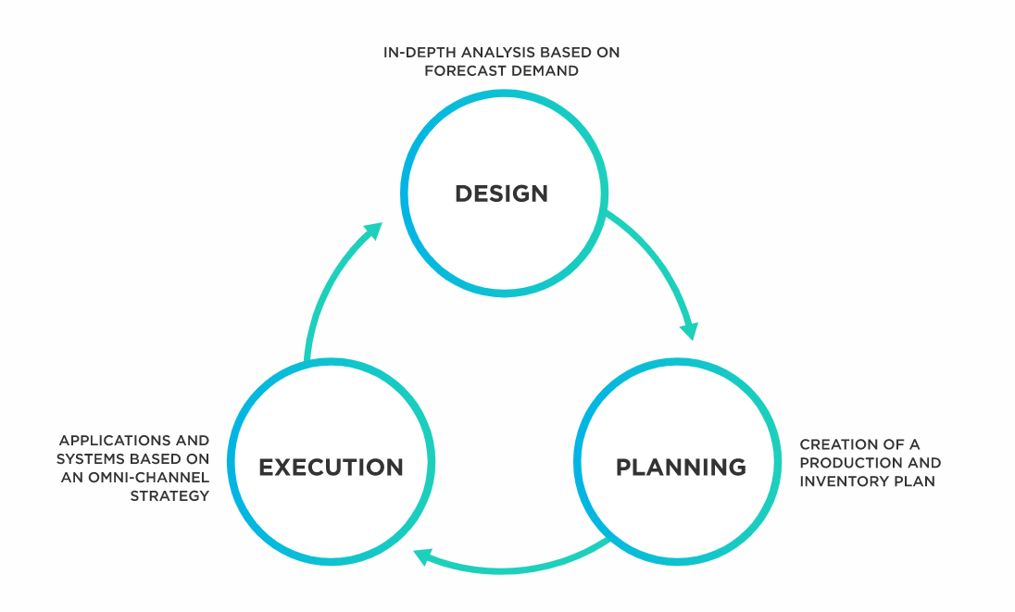
What is supply - chain optimization?
Supply chain optimization is the adjustment of a supply chain’s operations to ensure it is at its peak of efficiency. Such optimization is based on certain key performance indicators that include overall operating expenses and returns on the company’s inventory. The aim is to provide customers with the products at the lowest total cost possible while retaining the highest profit margins. To achieve these goals, managers have to balance costs incurred in manufacturing, inventory management, transportation, and fulfillment of customer expectations.

Slide 4

Over view
Supply chain optimization is the process of improving the performance and efficiency of the supply chain by identifying areas that need improvement and implementing strategies to address them. The goal is to create a more efficient, cost-effective, and responsive supply chain that meets the needs of customers while reducing waste and improving profitability.
To demonstrate the benefits and potential of using predictive analytics in supply chain management. By using predictive analytics to optimize the supply chain, companies can improve their operations, reduce costs, and enhance customer satisfaction. The project aims to showcase how predictive analytics can be used to analyze large volumes of data, identify patterns, and make accurate predictions that can help companies optimize inventory levels, transportation routes, and production planning. Ultimately, the project aims to provide insights and guidance for companies seeking to leverage predictive analytics in their supply chain management practices to remain competitive and successful in today's dynamic business environment.
purpose

Slide 5
Few key areas of the supply chain that can be optimized
Inventory management: This involves managing inventory levels to meet customer demand while minimizing the costs associated with storing and managing inventory.
Transportation: This involves optimizing transportation routes, modes of transportation, and carriers to reduce transportation costs and improve delivery times.
Production: This involves optimizing production processes and scheduling to ensure that products are manufactured efficiently and delivered on time.
Logistics: This involves optimizing the flow of goods and services from suppliers to customers, including warehousing, distribution, and fulfillment.
By optimizing these areas of the supply chain, companies can reduce costs, improve efficiency, and enhance the overall customer experience. The end result is a supply chain that is better equipped to meet the demands of a rapidly changing market and remain competitive in the long run.

Slide 6
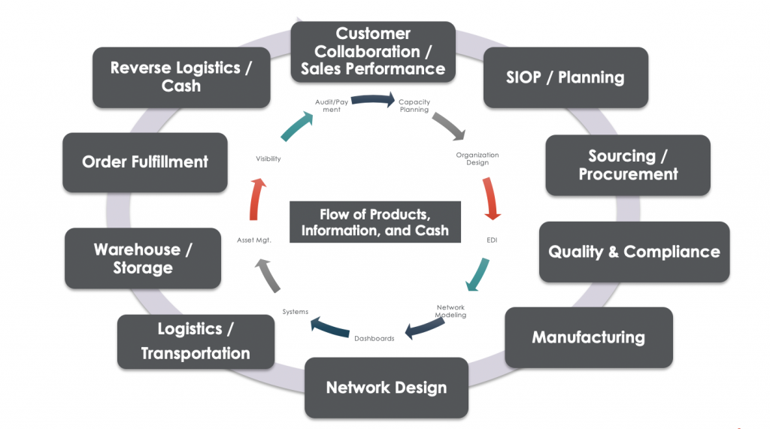
Optimized Supply chain drives value by enabling the right products in the right place at the right time at the optimal price. It is enabled by customer service, planning, technology and sourcing enterprises:

Slide 7
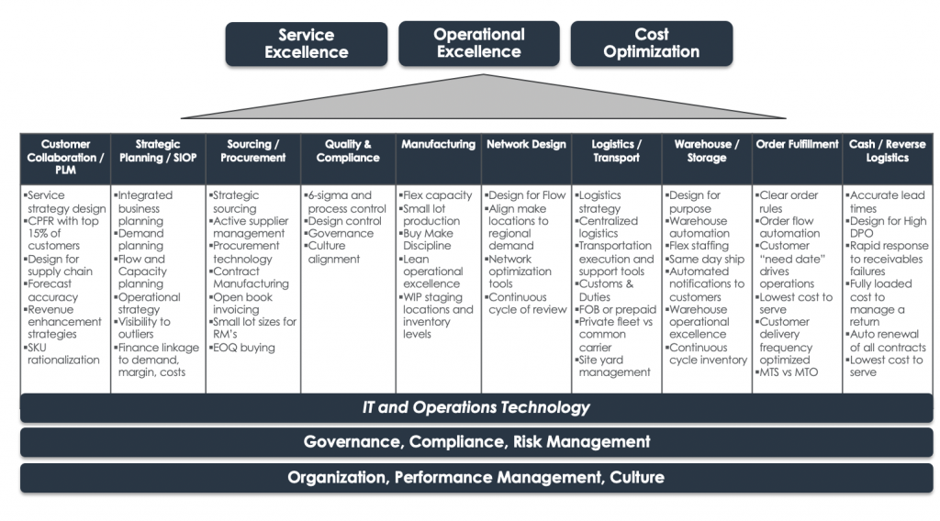
the process and critical tasks for each function area that makes up the operational supply chain:

Slide 8
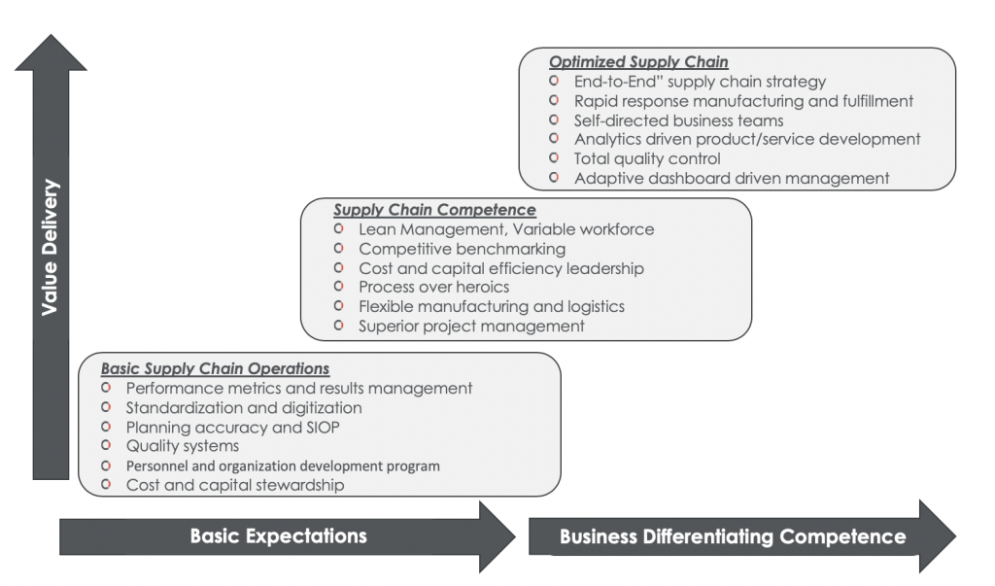
Supply Chain optimization is the path to sustained performance, proper cost and quality delivery, and the foundation to drive business differentiation:

Slide 9
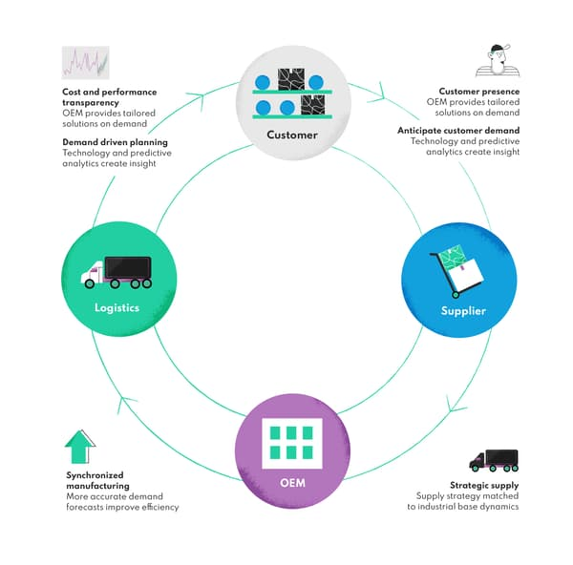
Predictive analytics can be used in supply chains across various departments, including production, logistics, operations management, marketing, sales, customer service, etc. Based on BCG Analysis

Slide 10
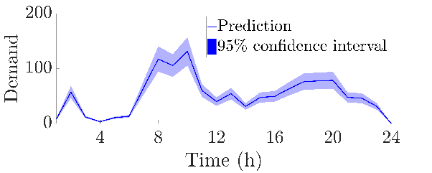
Predictive Analytics Use Cases in Logistics and Supply Chain
Demand Prediction
Forecasting is about anticipating future events based on patterns found in historical data sets; it’s mostly about finding a suitable mathematical model that accurately forecasts future trends and predicts what will happen given specific variables or conditions. It helps to indicate everything from sales volumes of individual products, market demands, seasonal fluctuations, etc.
Predictive analytics gives companies the ability to predict future customer demand. This is one of the most significant advantages predictive technology offers. It allows organizations to take steps before an actual increase in sales occurs, not after customers start complaining about missed deadlines and lost revenue opportunities). Demand forecasting can predict future market trends and supply accordingly, helping in enterprise resource planning. As an example, the predictive model could help companies estimate the demand for their products in a specific region, so they could either expand production or look for partners with spare capacities who could provide additional units at certain times when sales are expected to increase.

Slide 11
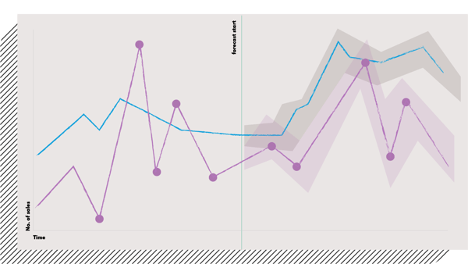
Predicting sales based on past patterns in demand to optimize the production and transportation processes.

Slide 12
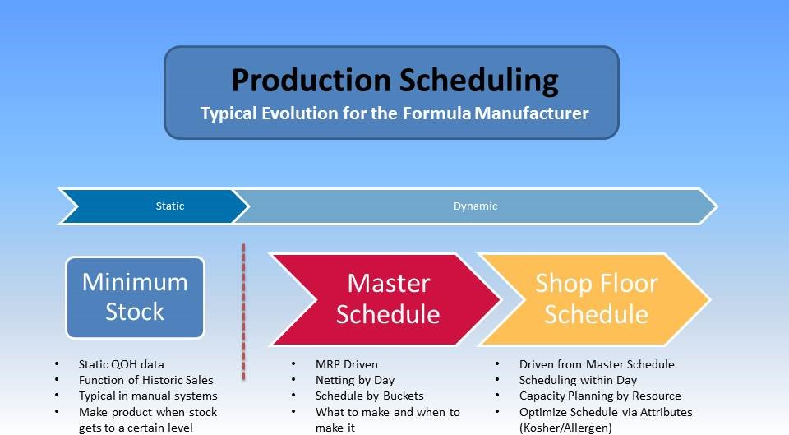
Production Scheduling
Predictive modeling is advantageous when it comes to production planning and scheduling. By considering all available data from past sales history, demand forecast, etc., companies can make sure that they have the right amount of materials on hand for production within a given time frame. Companies can use supply chain analytics to plan their production activities. This is possible through demand planning, forecasting, and optimization applications. The results of these predictive models are combined with other relevant data about costs, capacities, etc., which give companies the ability to determine how much inventory they need for each product at specific times or regions throughout a year.
From my perspective, companies evolve into their production scheduling process as their business evolves. Attempting to implement a complex master production schedule model when a company is beginning to automate their ERP manufacturing process is often a mistake. The key is to take a realistic view of what stage the company is in and grow from there.

Slide 13
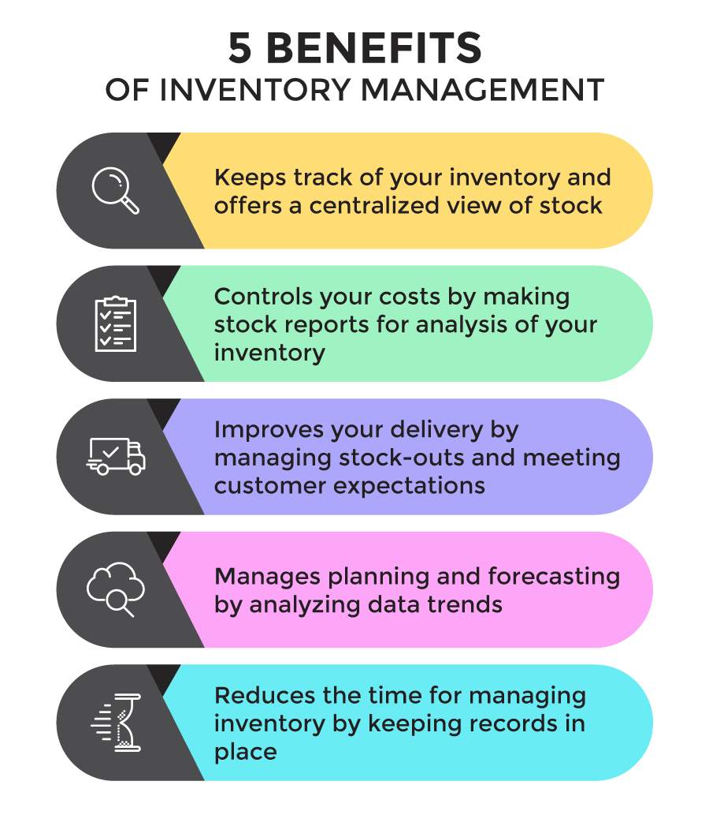
Inventory Optimization
Inventory management is one of the most critical processes that predictive analytics can improve. This use case allows companies to make the most out of their supply chain management processes. Having too much inventory in stock can be costly, while not having enough for expected sales could mean losing potential customers. The predictive model helps organizations maintain just the right level of supplies at all times - which usually means lower investment costs and less waste due to overproduction or understocking.

Slide 14
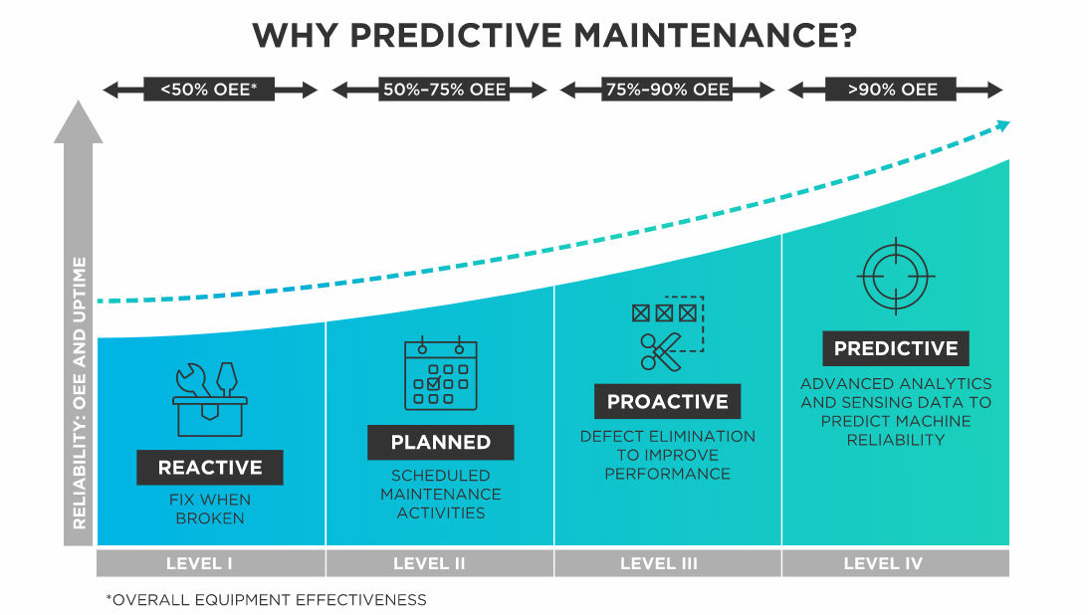
Predictive Maintenance
A predictive analytics solution can help supply chain managers reduce operational costs and downtime by identifying potential problems before they occur. In addition to predictive analysis for production planning and scheduling, companies can use predictive models to simplify the maintenance process, helping avoid expensive breakdowns that could have been prevented with little preparation.
Predictive maintenance, also referred to as condition-based maintenance, involves performance monitoring and equipment condition monitoring during regular operations to reduce the chances of a breakdown. Manufacturers began using predictive maintenance in the nineties.

Slide 15
Steps to Implement Supply Chain Optimization using Predictive Analytics:
Identify Business Objectives:
Develop Predictive Models:
Test and Refine Predictive Models:
Collect and Analyze Data:
Define Key Performance Indicators (KPIs):
Integrate Predictive Analytics into Your Supply Chain Operations:
Continuously Monitor and Improve Performance:

Slide 16
To implement predictive analytics in a company's supply chain, several tools and technologies are required, such as:
Data analytics software: Software such as SAS, R, and Python are commonly used for predictive analytics.
Data visualization tools: Tools such as Tableau and Power BI can be used to visualize the data and present the results.
Cloud computing: Cloud computing platforms such as Amazon Web Services and Microsoft Azure can be used to store and process large amounts of data.
Internet of Things (IoT) devices: IoT devices such as sensors and RFID tags can be used to collect real-time data on inventory levels, production output, and transportation routes.

Slide 17

Case studies:
Case Study 1:Walmart
Walmart, one of the largest retailers in the world, has been implementing predictive analytics to optimize its supply chain. The company uses analytics to forecast demand for its products, which allows them to make better decisions on inventory management and procurement. With the help of analytics, Walmart has been able to improve its in-stock availability and reduce the inventory carrying costs, resulting in significant cost savings. Moreover, the company has been able to identify areas where it can reduce waste and increase efficiency, such as optimizing truck routes to reduce transportation costs.

Slide 18
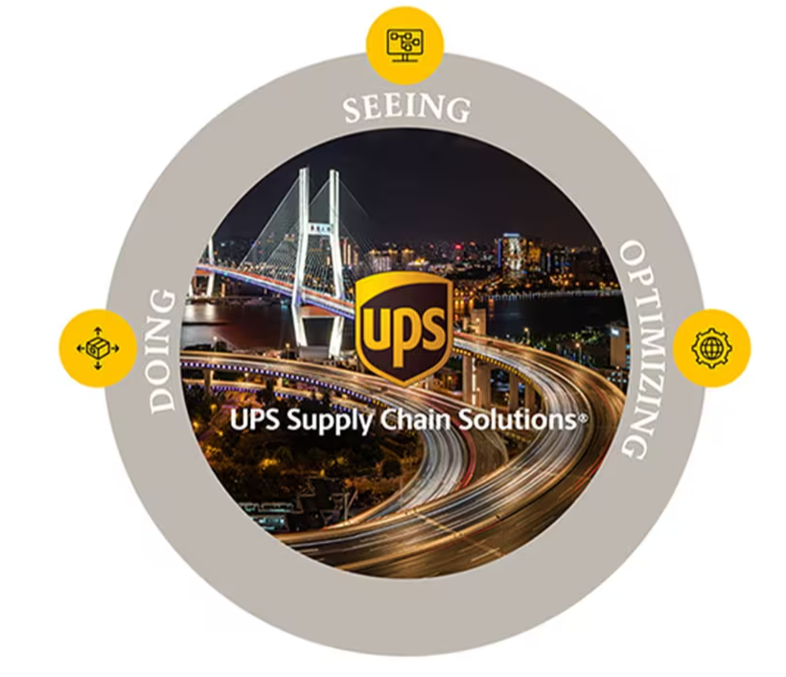
Case Study 2:
UPS, the global logistics company, has also been using predictive analytics to optimize its supply chain. The company uses analytics to forecast package volumes and optimize its delivery routes, which has resulted in significant cost savings. UPS has also been using analytics to improve its warehouse operations, such as optimizing inventory levels and reducing picking times. By implementing predictive analytics, UPS has been able to reduce its operating costs while improving its delivery performance.

Slide 19
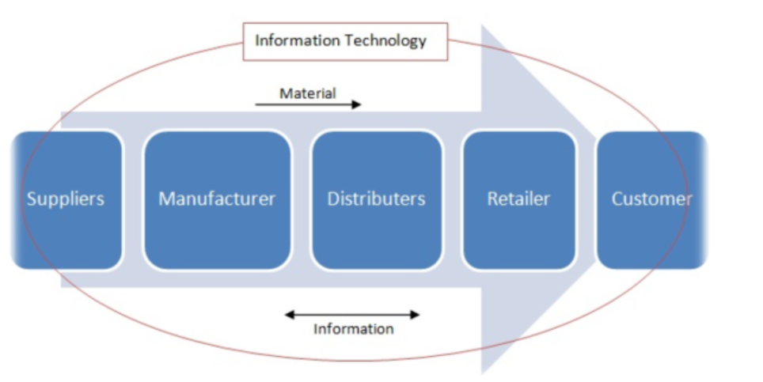
Case Study 3:
Procter & Gamble (P&G), a multinational consumer goods company, has been using predictive analytics to optimize its supply chain for several years. The company uses analytics to forecast demand for its products, optimize inventory levels, and manage its transportation network. With the help of analytics, P&G has been able to reduce its inventory holding costs and improve its delivery performance. Moreover, the company has been able to identify areas where it can improve efficiency, such as optimizing its manufacturing processes and reducing waste. By implementing predictive analytics, P&G has been able to improve its profitability and stay competitive in the market.

Slide 20
Challenges and Limitations:
While supply chain optimization using predictive analytics offers numerous benefits, there are also some challenges and limitations that need to be considered. Some of these include:
Data Quality: Predictive analytics relies heavily on data quality, accuracy, and completeness. Poor data quality can lead to inaccurate predictions and flawed decision-making.
Resource Allocation: Implementing predictive analytics requires significant resources, including technology infrastructure, skilled analysts, and data scientists. This can be a significant investment for smaller businesses and may require significant budget allocation.
Resistance to Change: Implementing predictive analytics can also face resistance from employees who are used to traditional decision-making processes. Companies may need to invest in training and change management initiatives to overcome this.
Uncertainty: Despite the use of advanced analytics, there can still be uncertainties in supply chain optimization due to unforeseen events like natural disasters, supply chain disruptions, or geopolitical factors.
Ethical Concerns: The use of predictive analytics can raise ethical concerns, especially in relation to data privacy and security. Companies must ensure that their use of predictive analytics aligns with ethical guidelines and regulations to avoid potential legal or reputational risks.
It is essential to recognize and address these challenges to ensure successful implementation of supply chain optimization using predictive analytics.

Slide 21
Conclusion:
supply chain optimization using predictive analytics can significantly reduce costs, improve efficiency, and enhance overall performance. The benefits of predictive analytics are numerous, including increased visibility, improved demand forecasting, enhanced inventory management, and better decision-making capabilities. The steps to implementing supply chain optimization using predictive analytics involve identifying data sources, selecting an analytics platform, developing predictive models, and integrating the results into supply chain operations. However, there are also challenges and limitations that must be addressed, such as data quality, resource constraints, and the need for skilled data analysts. Nonetheless, the potential benefits make supply chain optimization using predictive analytics a valuable investment for companies looking to gain a competitive advantage and achieve long-term success in their supply chain operations.

Slide 22
References:
Predicting the Unpredictable: Pragmatic Approaches to Estimating Cost or Schedule By Johanna Rothman
Supply Chain Analytics and Modelling: Quantitative Tools and Applications by Dr Nicoleta Tipi
https://www.reference.com/business-finance/analytical-research-94534a536bf46028?utm_content=params%3Ao%3D740005%26ad%3DdirN%26qo%3DserpIndex&ueid=6aa0b095-a240-497f-b95d-f79bd7c9c98d
https://www.ey.com/en_us/alliances/pegasystems?WT.mc_id=10818220&AA.tsrc=paidsearch&gad=1&gclid=Cj0KCQjwmN2iBhCrARIsAG_G2i5TvkC4i-NmRq7dspe59bQ_EoO-mztWjI_OPxSIKU29tBw9kDu1108aAt9EEALw_wcB

Slide 23
Thank you

